Slide 1
Week-13: Gladiators
Team Members: Shivani Asokumar, Akash Narang, Mit Jain, Juhi Malkani
Team Lead: Akash Narang

Slide 2
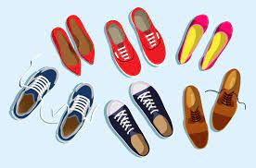
Project: E-commerce Website for Footwear

Slide 3
Team Progress Update
New: Static Login page
New: Seller page/add product
New: filter by brands
Shopping Cart feature
Frontend
New: Auth module
Seller Page API
Individual Product Page, Shopping Cart APIs
New: Website can be hosted
Backend

Slide 4
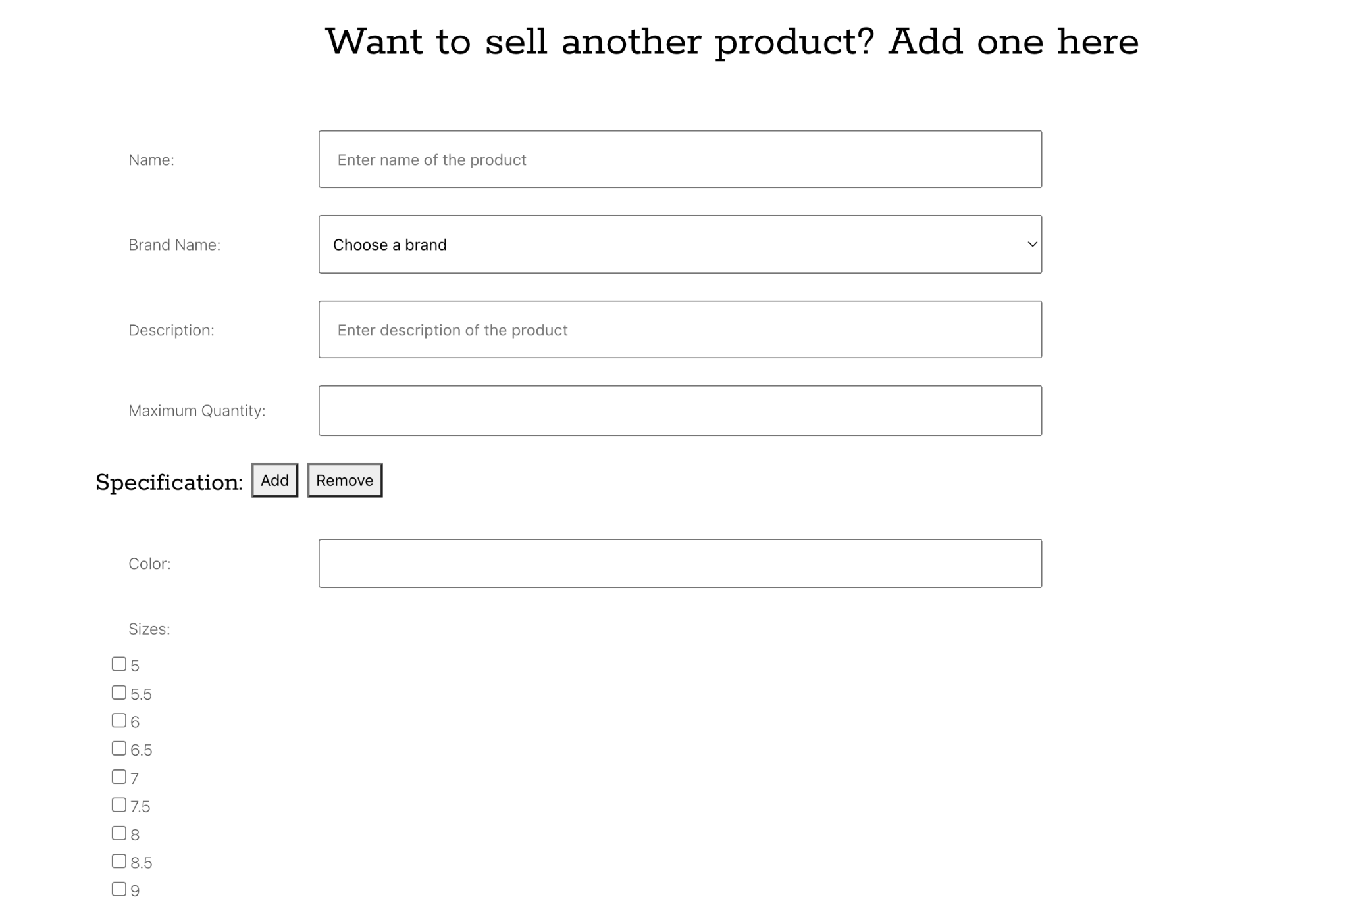
Seller Page (Completed)

Slide 5
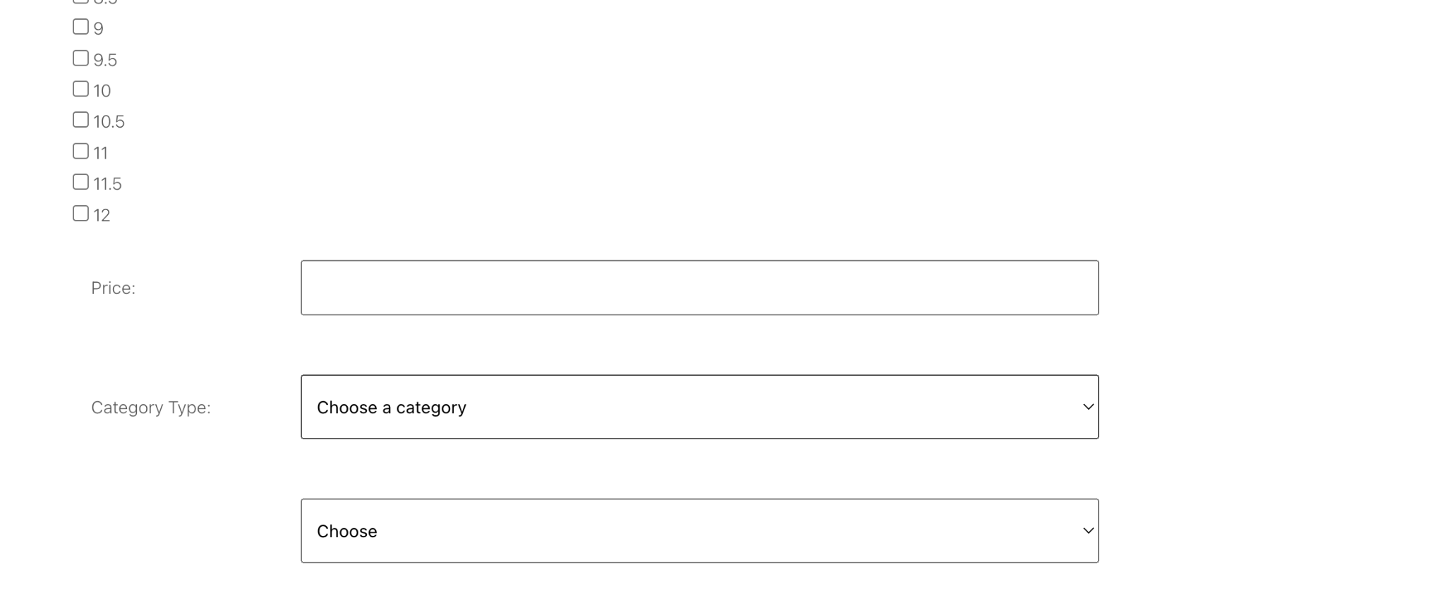
Seller Page (Completed)

Slide 6
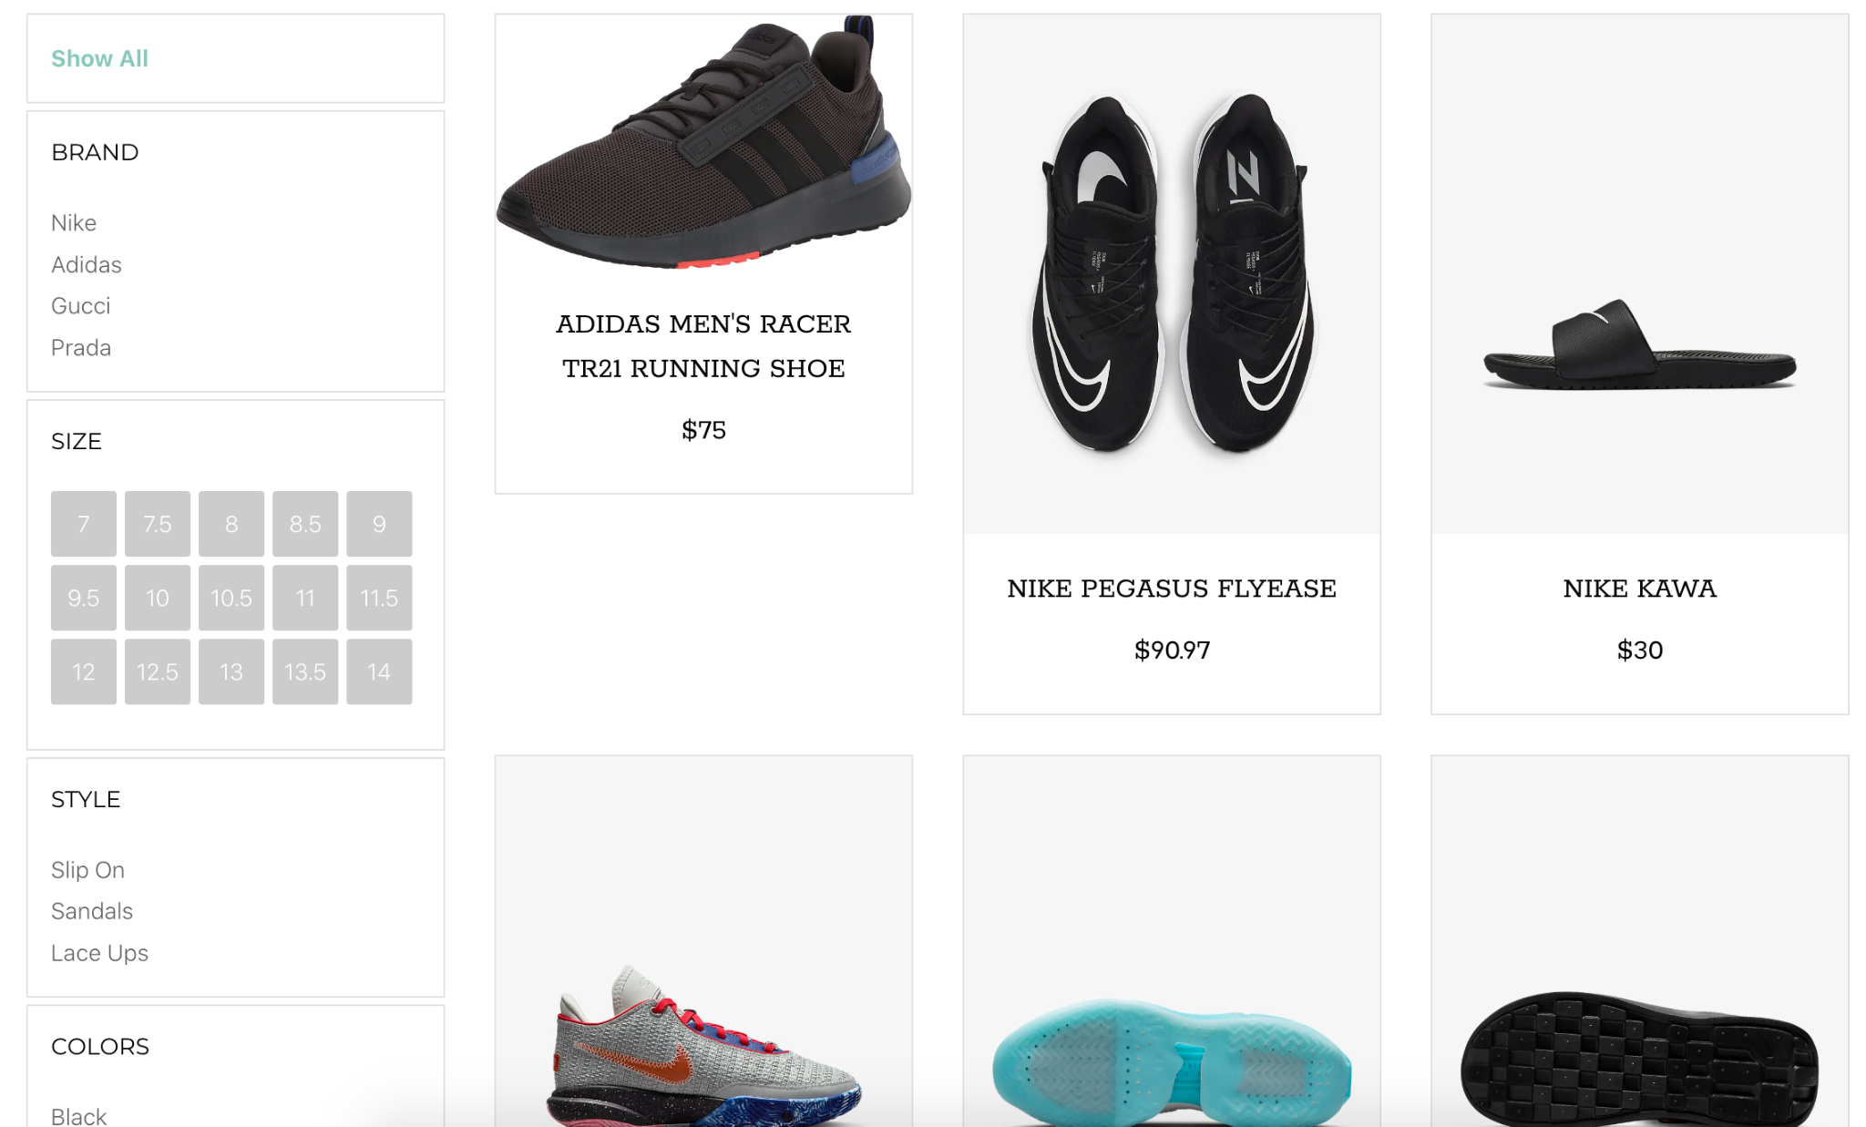
Product Listing

Slide 7
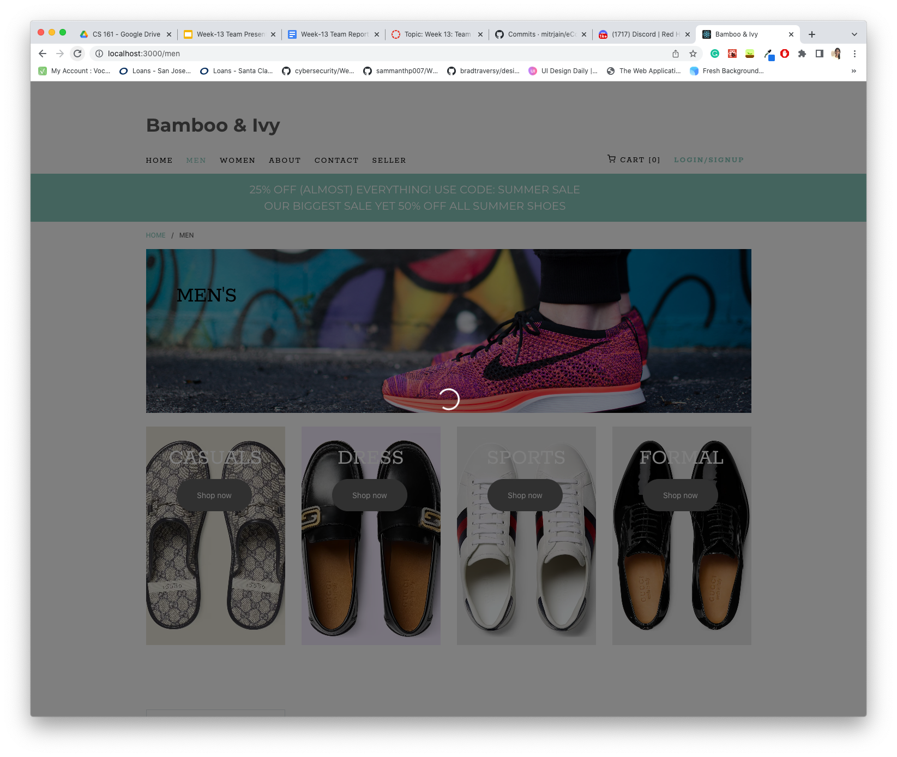
Loading Icon

Slide 8
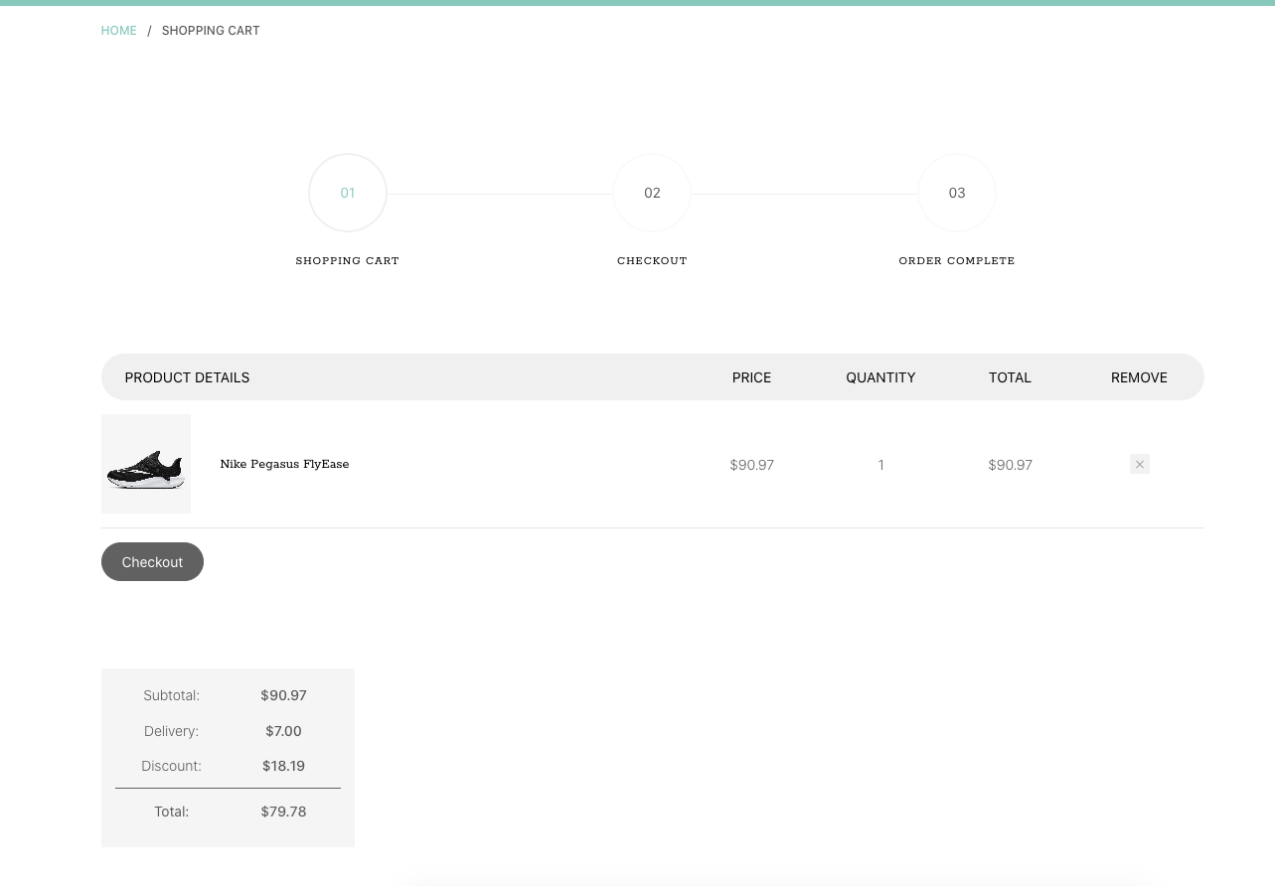
Shopping Cart

Slide 9
Milestones
M1
Seller Page
M2
Shopping Cart
M3
Men/Women
Best Sellers
M4
User Auth
Order Summary
M5
Checkout/Payment

Slide 10
Feedback
Text over homepage image is hard to read (Librarians)
Trusted partners appears twice (Librarians)
Seller page menu not highlighted (Librarians)
UI is nice and clean, easy to use (ThriveToday)

Slide 11
Thanks!

